Slide 1
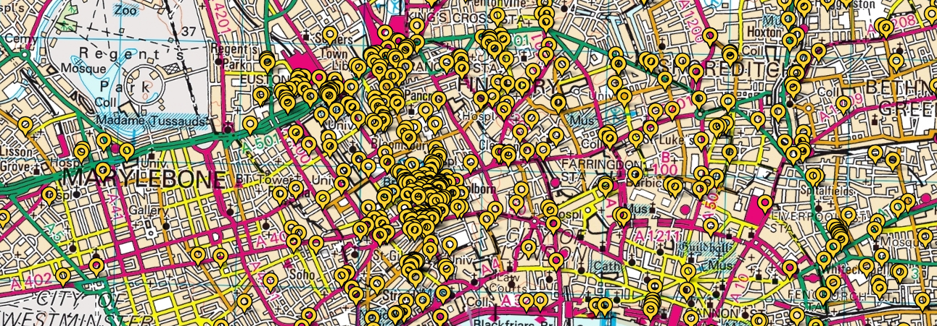
SAUSI (Spatial Annotation for Urban Space Improvement) Implementation, Deployment & Networking Strategies
Simone Tosoni: simone.tosoni@unicatt.it

Slide 2
SAUSI (Spatial Annotation for Urban Space Improvement)
Researching SAUSI:
Software analysys
Software usage analysys
Interview with developers
Experimanetal Design sessions
Tarantino - Tosoni, “Spatial Annotation for the Improvement of Urban Space: A Learning-by-Doing Approach” in The Electronic Journal of Communication, 24 (1-2), 2014
SAUSI Systems:

Slide 3
SAUSI: smartifying the city from below? (I)
”CITIZENS AS SENSORS”
AS CARE
CIVIC ENGAGEMENT
AS PARTICIPATION

Slide 4
SAUSI: Impact
In 2016: weak penetration of SAUCI systems outside the UK.
Last week’s reports in Fixmystreet
UK: 3500
France (2015) 0
Ireland (2012) 117
Norway (2011) 143
Spain (2015) 12
Sweden (2013) 39
Switzerland (2013) 58
Italian Municipalities served by the two main italian SAUSI systems (on 7998)
Decoro Urbano: 261
Comuni-Chiamo: 79

Slide 5
SAUSI: smartifying the city from below? (II)
Skepticism on the sort of “civic engagement” fostered by SAUSI systems.
”Procedural” problems only
Non negotiable roles assigned to citizens and municipalities
Non-active role of citizens

Slide 6
SAUSI as Interfaces Between Citizens and municipalities
IMPLEMENTATION, DEPLOYMENT & NETWORKING ISSUES
1) Extension of the deployment
2) Networking Strategy
3) Users Base Segmentation and Expansion

Slide 7
SAUSI: EXTENTION OF THE DEPLOYMENT
FixMyStreet:
Forwarding reports to 98% of Municipalities
“Active” municipalities are provided with a Reports Management System
Decoro Urbano & Comuni-Chiamo:
Accept reports only in “active” municipalities

Slide 8
SAUSI: networking strategy
CITIZENS ONLY
“ALL” STAKEHOLDERS

Slide 9
SAUSI: USER BASE SEGMENTATION AND EXPANTION
ABSTRACT “CITIZENS”
SPECIFIC “USERS”

Slide 10
CONCLUSIONS
SAUCI: A (TECHNOLOGICAL) OPPORTUNITY WE ARE STILL UNABLE TO SEIZE
RELATIONSHIP BETWEEN ICTS AND GOVERNANCE TO BE ADDRESSED AS A SOCIOTECHNICAL PROBLEM
THANK YOU! Simone.Tosoni@unicatt.it

