Slide 1
Environmental Informational Governance: Some Implications & Questions
Matteo Tarantino
Confucius Institute of the University of Geneva

Slide 3
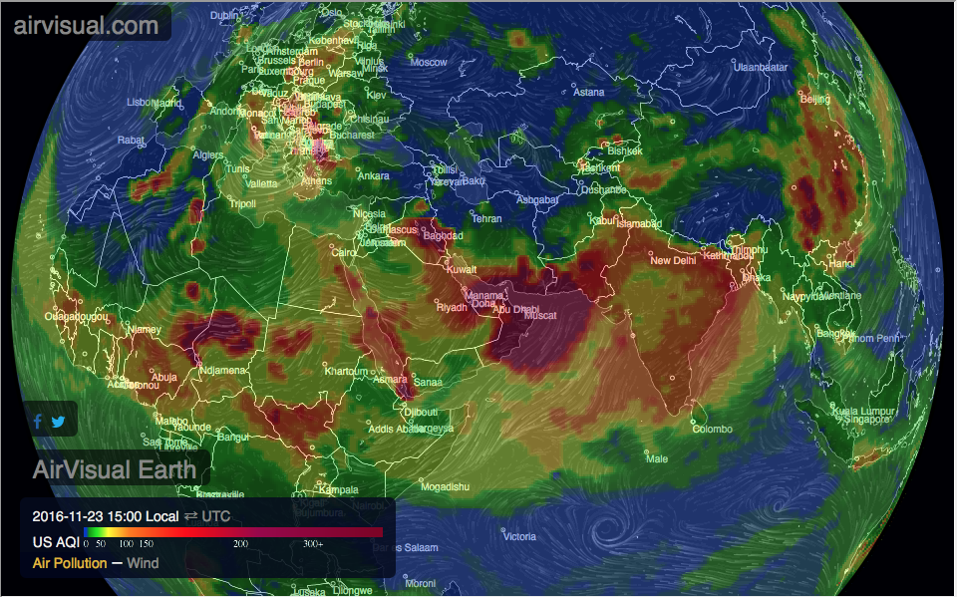

Slide 4
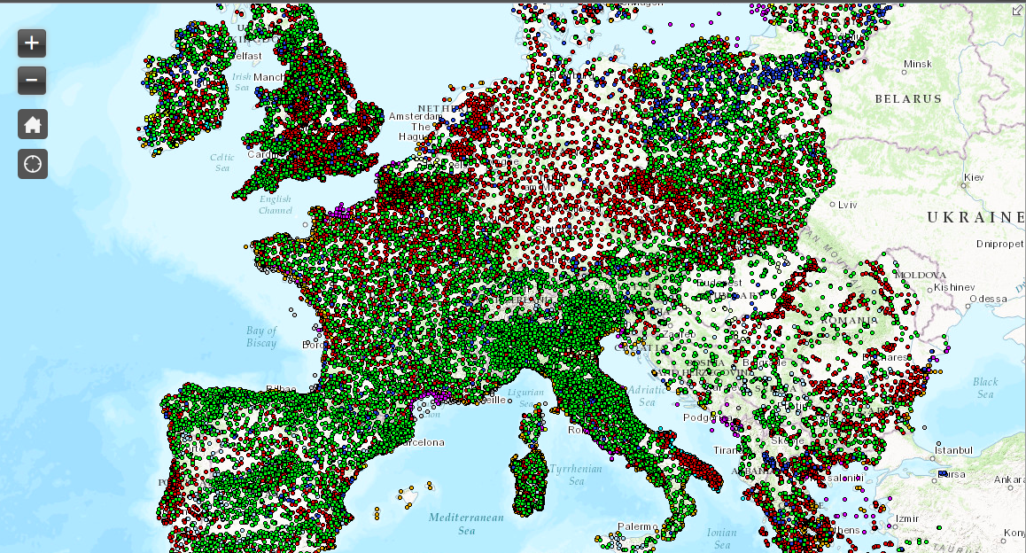
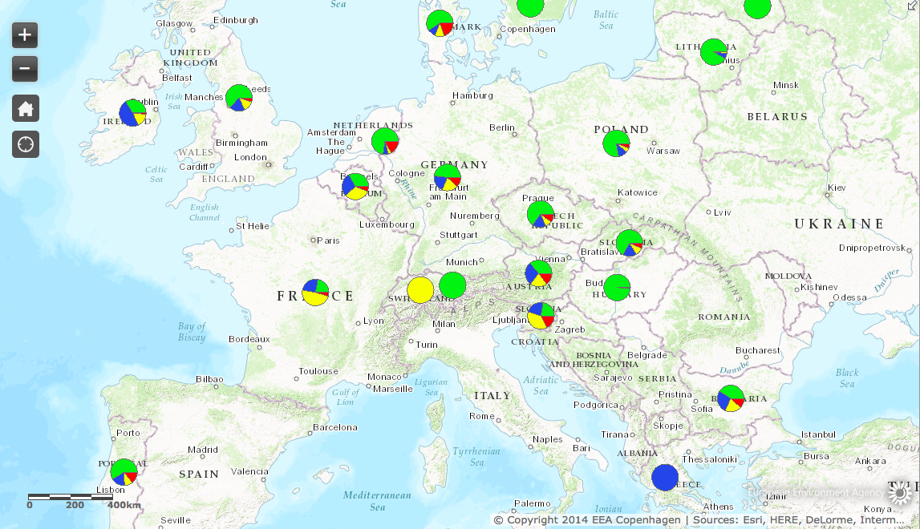
[this] situation [of fragmentation] of monitoring surface and ground water is determined probably by both technical and political problems.
In the EU, the Member States are responsible for monitoring the waters with more or less comparable approach.
In Germany there are the Länder that operate the water monitoring.
Harmonization in the EU is also difficult because of the different stages of development of the monitoring systems. [Germany Environmental Ministry, Private Email, 2015]

Slide 5
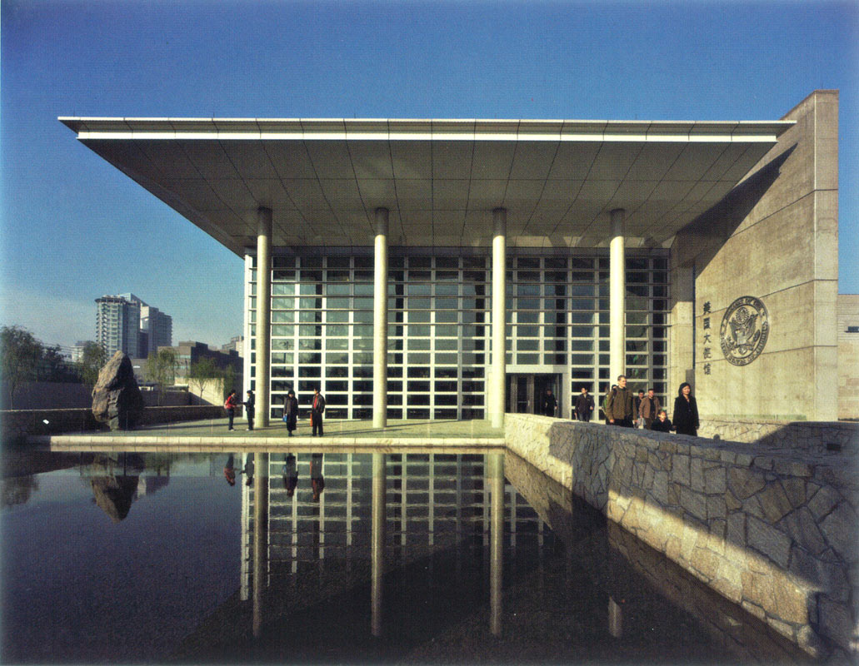
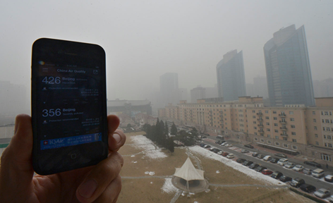

Slide 6
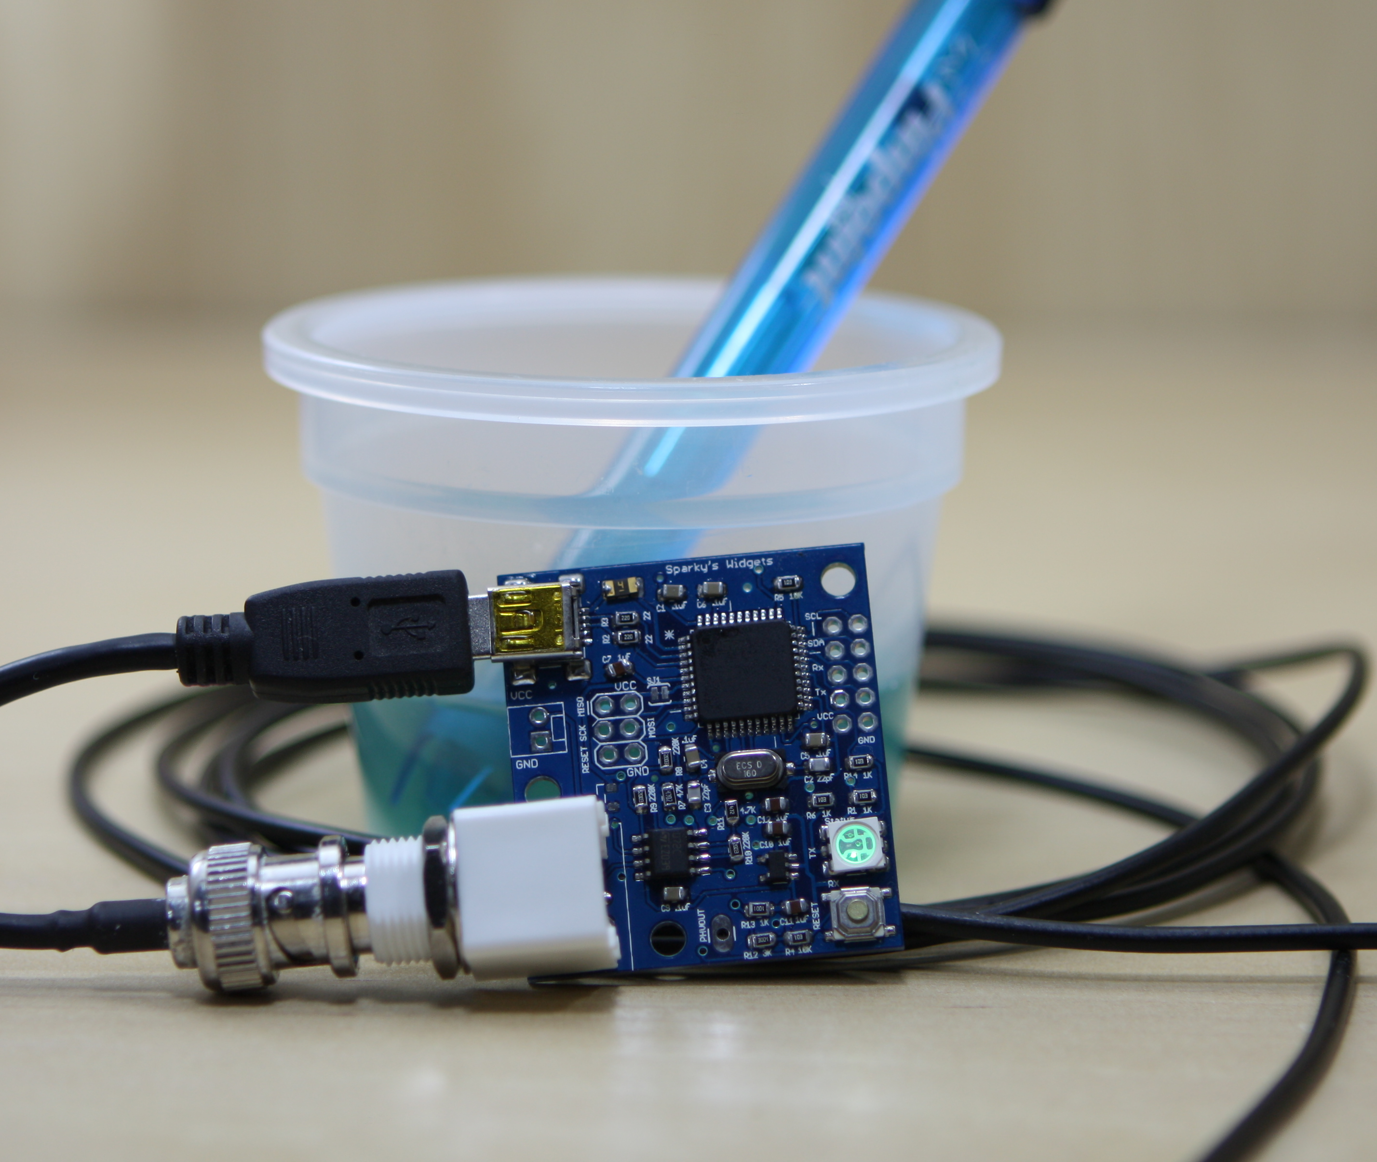

Slide 7
