Slide 1
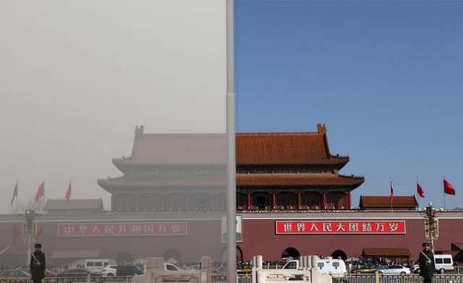
Environmental Campaigns in China through Social Media : Opportunities and Limits Yixian Sun Department of International Relations/Political Science Graduate Institute of International and Development Studies
Workshop “ICTs And Governance In Europe and China”
November 25, 2016, Confucius Institute, Geneva

Slide 2
Overview
1. PM 2.5 campaing in 2011-2012
Fedorenko, I., & Sun, Y. (2016). Microblogging-Based Civic Participation on Environment in China: A Case Study of the PM 2.5 Campaign.
VOLUNTAS: International Journal of Voluntary and Nonprofit Organizations. Vol. 27, Issue 5, pp 2077–2105.
2. Recent campaigns on sustainable consumption

Slide 3
Background
Two parallel trends in contemporary China
Notes:
30,000 to 50,000 so-called mass incidents every year, environmental pollution is a major cause
The development of environmental activism and the bloom of the Internet in China are mutually constitutive, but little research has examined empirically the emergence and process of online environmental advocacy

Slide 4
Research Question
ICTs change the width and speed of information transmission
“online activism” – Internet-based collective action that promotes, contests or resists change (Yang 2009)
“Increased use of mobile phones and the Internet has allowed protesters to show their anger more effectively.”
--- a member of the national committee of the CCPCC
How the public have been mobilized in social media (microblogging)-based environmental campaigns?
Actors and their networks
Social norms
Notes:
The development of environmental activism and the bloom of the Internet in China are mutually constitutive, but little research has examined empirically the emergence and process of online environmental advocacy
- Major actors and their networks
- Social norms embedded in today’s environmental campaigns

Slide 5
Analytical Framework I
ICTs provide new opportunities for Chinese environmental activists – “green public sphere”
Horizontal and Vertical interactions in the online space
(Yang and Calhoun 2008, Yang 2009, Xie 2009)
Features of Sina Weibo (a twitter-like platform):
Dominance of a single one platform - More than 300 million in 2012
Users include many public figures and government agencies
Anonymous posting
Propositions:
Promoting intensive horizontal interaction among environmental activists, and between activists and citizens, involving a wider public
Enabling vertical interaction between the government on the one hand, and environmental activists and the public on the other.

Slide 6
Analytical Framework II
Framing strategy to mobilize the public in China’s authoritarian setting
Public mobilization needs a frame having a wider resonation within society, employing personal concerns, and being not critical towards the government.
(Mertha 2010)
Environmentalism vs. NIMBYism (Johnson 2010)
Proposition:
→ The link between air pollution and public health is crucial to explain the success of the air pollution campaign

Slide 7
Research Design
A single case study:
a large-scale campaign against air pollution across the country from October 2011 to early 2012, based on Sina Weibo, the then most influential social media in China; considered as the biggest victory of civil society in the history of environmental campaigning in China.
Methodology:
process tracing, discourse analysis, semi-structured interviews (18), and participant observations.

Slide 8
Campaign process
Sept-Oct 2011
Thick smog was appeared in many Chinese cities, but official data showed the air quality as “qualified” or only “mild polluted”.
Many people started to discuss online about air pollution, Weibo soon became a public sphere for relevant discussions.
Late Oct.
The term “PM 2.5” became highly popular on the online public - thousands of microblogs were calling for strengthened air quality standards in China to monitor PM2.5.
Dec.
Nov 16
Discrepancies between the Chinese government’s Air Pollution Index and an Air Quality Index published by the US Embassy in Beijing triggered intense online debates
A mass online protest has occurred across the country on Weibo
MEP elaborated a draft of the new National Ambient Air Quality Standards which include the monitoring of PM2.5, but only requires compulsory implementation in 2016
Dec. 26
Many provincial and municipal governments expressed their willingness of implementing immediately the new standards, but campaign participants were unsatisfied with the MEP’s decision and openly called it into question on Weibo.
The then Chinese environment minister announced that big cities and cities in the developed areas will be required to implement the new standards in 2012, this decision was officially confirmed by the State Council on February 29, 2012.
Oct.

Slide 9
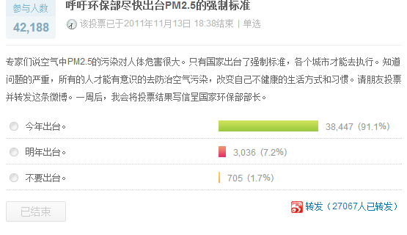
Critical Juncture
The online poll in 6 -13 Nov 2011, initiated by Pan Shiyi
“Experts said PM2.5 in the air is extremely dangerous to the human. Only if the compulsory standards can be imposed by the state, every city can implement them. Once people understand the seriousness of the problem, everyone can spontaneously prevent air pollution, change their unhealthy habits and lifestyles. Please vote and share this weibo. In one week, I will write a letter with the result of this vote to the environment minister.
This year
Next year
Never”
Source: http://vote.weibo.com/vid=1127783

Slide 10
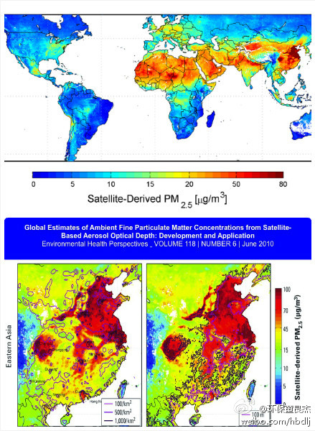
Key actors and relevant social networks
A milestone of civic participation in China:
the public has directly influenced a policy at the national level.
Leading role of environmental activists
Environmental activists expressed their concern on PM2.5 on Weibo before the problem moved under spotlight.
Key figures are far more active than lay people in the campaign – produce new information and set new agenda.
The Weibo platform helped environmental activists to create a “matter of concern” (i.e. PM 2.5) as a basis of the large-scale online protest that has involved a wider public including public figures and ordinary internet users.
Notes:
Key figures are far more active than lay people in the campaign by producing new information and setting new agenda.

Slide 11
Actor networks in the PM 2.5 campaign
Celebrities and citizens willing to tackle air pollution
Network of green discourse and knowledge established by environmental activists
Ordinary Internet users

Slide 12
Vertical Interaction
Lively exchange on Weibo between some governmental officials and the public/environmental activists
The then deputy Director of Beijing Bureau of Environmental Protection
Weibo accounts of many local governmental agencies became the targets of public protests, and their proactive response to questions and critiques from the public further encourage public participation
In early November, the Meteorological Bureau of Nanjing said the city was prepared for monitoring PM2.5 and disclosing related data.

Slide 13
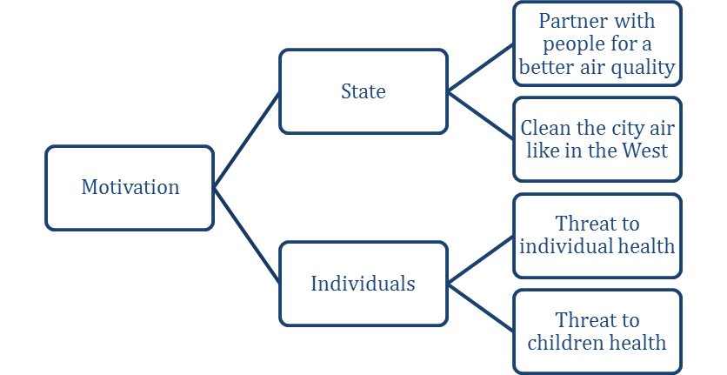
Framing in the PM2.5 campaign
Diagnostic framing – identify injustice and attributing blame to something
Prognostic framing – articulate possible solutions
Motivational framing – give people a reason to act
26 articles with referencing to PM 2.5 have been analyzed from major Chinese and foreign newspapers and the Chinadialogue website.
Overall pattern: NIMYBism + Not blame the government

Slide 14
Findings
Social media platforms greatly expand the networks of Chinese environmental activists by involving influential public figures and governmental agencies.
The NIBYism frames liking air pollution to health, and the frames appreciating governmental efforts are critical to the success of civic participation in today’s Chinese environmental governance.

Slide 15
Recent Developments
Use of social media in campaigns for sustainable consumption
Goal: raise consumers’ awareness → change behaviors
New trends:
Leverage resources of various actors:
ENGOs (e.g. WWF), retailers (e.g. CCFA), intergovernmental organizations (UNEP), standard-setting organizations (e.g. MSC), product brands
Information sharing and online interaction through Wechat
Wechat has become the leading social media platform, 78.7% vs 34% for Weibo (CINIC 2016)
Notes:
Today users can “tag” people in pictures and posts, read news, start groups, organize protests, or pay for meals. With its convenient and versatile features, Weixin has spread widely.
comes packed with more tools than a Swiss army knife” while still giving users the option of privacy

Slide 16
Challenge 1: intimite circles
Are Wechat-based campaigns able to reach more people?
Wechat – a stronger sense of community, but smaller networks (“homophily effects”)
→ Need innovative solutions to make connections between different networks
Notes:
Homophily

Slide 17
Challenge 2: price premium and framing
Can such campaigns change people’s consumption behaviors?
Because of price premium, consumers may be unwilling to change pay more to buy sustainable products even if they understand social values embedded in these products
Potential solution: emphasis on other salient issues than sustainable development, such as food safety

Slide 18
Future Research
More empirical research on effectiveness of such campaigns
Consumer surveys to examine whether social media is a key channel of awareness raising
Experiments to which framing is the most effective one to change consumers’ behaviors

Slide 19
Thank you!
yixian.sun@graduateinstitute.ch

