Slide 1
Workshop on ICTs and Governance in Europe and China
Key performance indicators to shape Smart Sustainable Cities
Bilel Jamoussi Chief ITU-T Study Groups Department
25 November 2016

Slide 2
15 years of ICT Growth: What have been achieved ?
Mobile celular telephone subscriptions
Individuals using the internet
Fixed telephone subscriptions
Active mobile broadband subscriptions
Fixed broadband subscriptions

Slide 3
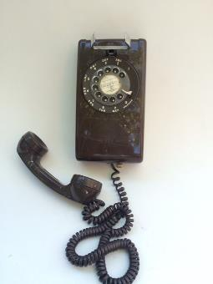
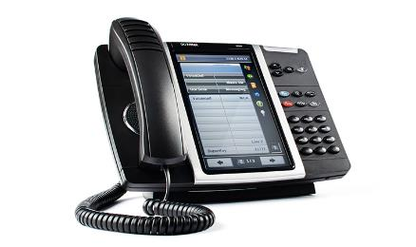
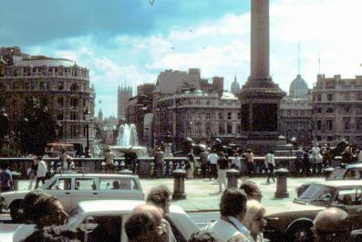
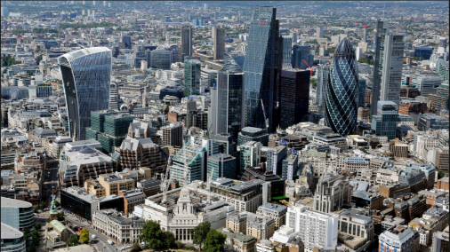
Technology is changing…
Our cities are changing…
London, 1980
London, 2016

Slide 4
Some facts about cities
By 2050, it is expected that 66% of the population in the world will be living in urban areas
Of today’s 28 mega-cities, 16 are located in Asia, 4 in Latin America, 3 each in Africa and Europe, and 2 in Northern America.
Cities contribute to up to 70% of the total greenhouse gas emissions.
By 2030, the world is projected to have 41 mega-cities with more than 10 million inhabitants
Half the world’s population will be online in 2018 and by the end 2018, 51.1% of the population (3.82 billion people) will be using the internet
Tokyo
Population 2030:
37 million
Delhi
Population 2030:
36 million
Mexico City
Population 2025:
24.6 million
Source: United Nations, Department of Economic and Social Affairs Statistics, Frost & Sullivan and other regional and country level statistics bureau
Notes:
Tokyo is projected to remain the world’s largest city in 2030
http://www.un.org/ga/Istanbul+5/16.pdf
https://esa.un.org/unpd/wup/Publications/Files/WUP2014-Highlights.pdf

Slide 5
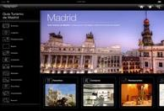
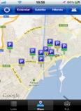
Cities challenges vs citizens’ interests
Waste & Water
Management
Tourism & cultural
engagement
i.e. Sao Paulo, New Delhi, Panama
i.e. Paris, Buenos Aires, Florence
Traffic & mobility
Management)
Business &
commerce
Cities interests
i.e. Beijing, Barcelona, Cairo
i.e. Berlin, New York, Tokyo.
Electricity Supply
Safety
i.e. Caracas, Germany
i.e México City, Rio de Janeiro
Sources: (1) McKinsey Global Institute - Big Data Report, May 2011. (2) 2012E, Strategy Analytics , Global Social Network Market Forecast, Oct 2011. (3) United Nations, April 2010, (4) Youtube 2011
Notes:
Cities face quite similar challenges, most of them related to sustainability

Slide 6
How do we shape Smarter and More Sustainable cities

Slide 7
Pathway for Smart Sustainable Cities
6. Ensure accountability and responsibility
1. Set the vision for your SSC venture
Smart Sustainability City cycle
5. Measure your city’s progress
2. Identify your SSC targets
4. Build your SSC
3. Achieve political cohesion
Guide for City Leaders

Slide 8
1. Set the vision for your SSC venture
2. Identify your SSC targets

Slide 9
3. Achieve political cohesion
4. Build your SSC
Many stakeholders are involved
City services companies
Utility providers
ICT Companies
National and regional governments
NGOs
Municipalities, City Council and city administration
International, Regional and Multilateral Organizations
Standardization bodies
Industry associations
Urban Planners
Citizens and citizen organizations
Academia, research organizations and specialized bodies

Slide 10
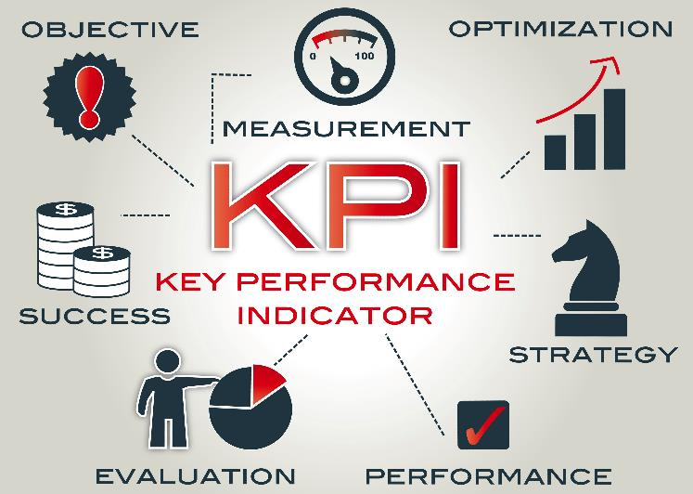
How do we know that our city is Smart and Sustainable?

Slide 11
Why KPIs are needed?
Shows what data to collect
Standardizes data collection
Shows gaps in policy
Shows areas for improvement
KPIs for Smart Sustainable cities help cities to achieve the
SDGs

Slide 12
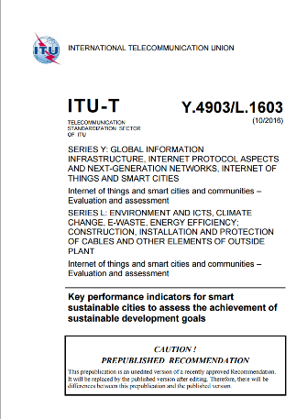
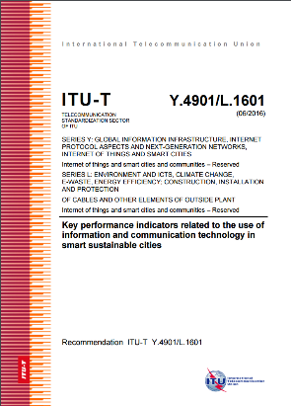
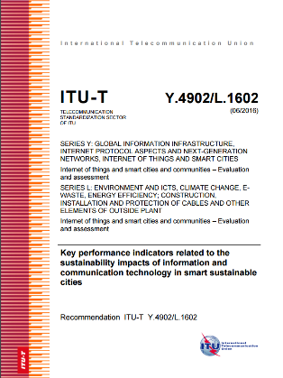
ITU-T Recommendations on KPIs for Smart Sustainable Cities
ITU-T Y.4901/L.1601 Key performance indicators related to the use of information and communication technology in smart sustainable cities
ITU-T Y.4902/L.1602 Key performance indicators related to the sustainability impacts of information and communication technology in smart sustainable cities
ITU-T Y.4903/L.1603 Key performance indicators for smart sustainable cities to assess the achievement of sustainable development goals, is currently being revised based on the inputs of 15 UN agencies, international organizations and cities
5. Measure your city’s progress

Slide 13
KPI structure
Dimension
Subgroup
Sub-dimension
ICT
Infrastructure
Productivity
Building
Electricity Supply
Employment
ICT infrastructure
Innovation
Noise
Productivity
Public sector
Roads
Transport
Urban planning
Waste and sanitation
Water supply
Core: 22
Economy
Advanced: 16
Energy
Environment
Infrastructure
Air quality
Energy
Environmental quality
Health infrastructure
Noise
Public spaces, nature and biodiversity
Waste and sanitation
Warer and sanitation
Water supply
Core: 19
Environment
Advanced: 7
Education, health and culture
Safety, housing and social inclusion
Culture
Education
Food Security
Health
Housing
Poverty
Core: 9
Safety - disaster
Safety - disaster relief
Safety – emergency
Safety – ICT
Social inclusion
Society and culture
Advanced: 16

Slide 14
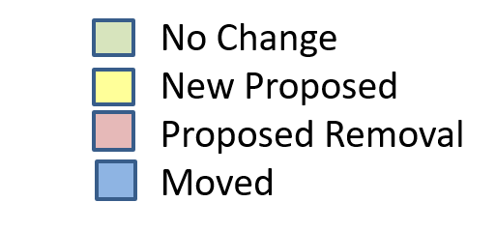
ECONOMY
ICT
CORE
Internet access in households Percentage of households with Internet access
Real-time public transport information Percentage of public transport stops and stations with real-time traffic information available
Availability of smart water meters Proportion of the water consumers with smart water meters.
Availability of Smart electricity meters Proportion of the electricity consumers with smart electricity meters.
Household with a computer
Percentage of households with at least one computer
Fixed broadband subscriptions
Households with Fixed (wired) broadband.
Wireless broadband subscriptions Wireless-broadband subscriptions per 100 inhabitants.
ADVANCED
Public Sector e-procurement
Percentage of public sector procurement conducted electronically
Public Sector Information Security Proportion of smart nation’s services and systems that obtained satisfactory rating for Information security audits
Traffic monitoring
Percentage of major streets monitored by ICT
Clean energy transportation
Percentage of EVs
Clean energy transportation
Percentage of shared vehicles
Public sector e-Invoicing Percentage of public sector e-Invoicing
Open data
Percentage of available open data of cities.
e- Public Services adoption
Public sector e-service adoption based on the top 10 public services available electronically
ICT Noise monitoring Number of outdoor installations with applied ICT based noise monitoring per km2
Electricity supply system management using ICT
ICT Drainage system monitoring Percentage of ICT-monitored drainage system
Clean energy transportation
Percentage of Shared bicycles
Water Supply ICT Monitoring Percentage of the water distribution system monitored by ICT

Slide 15
ECONOMY
Productivity
CORE
R&D expenditure Research and Development expenditure as a percentage of city GDP
Patents Number of new patents granted per 100 000 inhabitants per year
Employment rate % Employed
Youth Employment % Youth Employed
ADVANCED
SMEs Percentage of small and medium-sized enterprises (SMEs)
Creative industry employment Percentage of employees working in the creative industry
Tourism industry employment Percentage of employees working in the tourism industry
Labour productivity Value added per person employed.

Slide 16
ECONOMY
Infrastructure
CORE
Access to improved water source Percentage of city population with sustainable access to improved water sources
Electricity system outage frequency Average number of electrical interruptions per customer per year
Public transport network convenience Proportion of the population that has convenient access to public transport
Household sanitation Percentage of the households with access to improved sanitation facilities
Public building sustainability Percentage of public buildings with recognised sustainability certifications
Wastewater collection Percentage of households served by wastewater collection
Electricity system outrage time Average length of electrical interruptions
Public transport network Length of public transport systems per 100 000 inhabitants.
Solid waste collection Percentage of city population with regular solid waste collection.
Access to Electricity Percentage of households with lawful access to electricity
Bicycle Network Kilometres of bicycle paths and lanes per 100 000 population
ADVANCED
Water Supply loss Percentage of water loss in the water distribution system.
Urban development
and spatial planning Existence of a strategic city planning documents promoting compact development, mixed urban land use; and avoiding urban sprawl
Pedestrian infrastructure Portion of city with pedestrian, car free and traffic calming streets

Slide 17
ENVIRONMENT
Environment
CORE
Air pollution Air quality index (AQI)
Water Consumption Water consumption per capita
Wastewater treated Percentage of wastewater receiving primary treatment.
Solid waste treatment Percentage of solid waste disposed to sanitary landfills
Solid waste treatment Percentage of solid waste burnt in an open arear
GHG emissions (*) Greenhouse gas emissions per capita.
Availability of smart water meters Proportion of the water consumers with smart water meters.
Wastewater treated Percentage of wastewater receiving secondary treatment.
Solid waste treatment Percentage of solid waste treated by other means
Solid waste treatment Percentage of solid waste incinerated
Compliance with WHO endorsed EMF exposure guidelines
Quality of drinking water Index of compliance with standards
Wastewater treated Percentage of wastewater receiving tertiary treatment.
Solid waste treatment Percentage of solid waste recycled
Solid waste treatment Percentage of solid waste disposed to an open dump
Adoption of a consistent planning approval process with respect to EMF
Green areas and public spaces Publically accessible green areas and public spaces per 100 000 inhabitants.

Slide 18
ENVIRONMENT
Environment
ADVANCED
Air pollution monitoring system Number of outdoor installations of ICT
Native species monitoring Change of number of native species - Biodiversity Index
Exposure to noise Percentage of the city inhabitants exposed to noise levels
Drainage system management Percentage of drainage system monitored.
Air pollution forecasting, Air pollution measures
Protected natural area Percentage of city area protected as natural sites
Tree Canopy Area of urban territory covered by tree canopy
Sporting facilities Area of total public sports facilities per 100 000 inhabitants.

Slide 19
ENVIRONMENT
Energy
CORE
Renewable energy consumption Percentage of renewable energy consumed in the city.
Electricity consumption per capita Electricity consumption per capita
Public buildings energy consumption Annual energy consumption of public buildings
Infrastructure
CORE
Proportion of city population with potable water supply

Slide 20
SOCIETY AND CULTURE
Education, health and culture
CORE
Student ICT Access Percentage of students/pupils with classroom access to ICT facilities
Maternal mortality Maternal deaths per 100 000 live births.
Doctors Number of doctors per 100 000 inhabitants.
School enrollment. Percentage of school-aged population enrolled in schools
Electronic health records Percentage of city inhabitants with electronic health records.
Life expectancy. Average life expectancy indicates the number of years a newborn infant would live.
Higher education ratio
Percentage of city inhabitants with higher level education degrees.

Slide 21
SOCIETY AND CULTURE
Education, health and culture
ADVANCED
Adult literacy
In-patient hospital beds Number of in-patient public hospital beds per 100 000 inhabitants
Cultural infrastructure Number of the cultural institutions per 100 000 inhabitants
At Risk Population Percentage of inhabitants living in a zone subject to natural hazards
Health insurance Percentage of city inhabitants covered by health insurance.
Cultural resources online Proportion of cultural institutions and events for which online participation is offered.
Food security monitoring and surveillance Presence of food security monitoring and surveillance
Cultural Expenditure Percentage of expenditure on Arts and Culture
Food aid Percentage of inhabitants dependent on chronic food aid
Protected cultural heritage sites Percentage of city area related to protected cultural heritage sites.

Slide 22
SOCIETY AND CULTURE
Safety, housing and social inclusion
CORE
Information security and privacy protection Existence of systems, rules and regulations to ensure information security and privacy protection in public service.
Informal settlements Proportion of urban population living in slums, informal settlements or inadequate housing
Gender income equity Ratio of Average hourly earnings of female and male employees, by occupation, age group and persons with disabilities
City population living in poverty Percentage of city population living in poverty
Gini coefficient Income distribution in accordance with Gini coefficient.

Slide 23
SOCIETY AND CULTURE
Safety, housing and social inclusion
ADVANCED
Housing expenditure Percentage expenditure of income for housing
Natural disaster-related deaths Natural disaster related deaths per 100 000 inhabitants.
Risk and vulnerability assessments Checklist: a) city infrastructures available for resilience; b) vulnerability assessment; c)financial (capital and operation) plans to mitigate vulnerabilities; d)technical systems to implement the plans.
Emergency Service Response Time Average response time for Emergency Services
Disaster-related economic losses Natural disaster related economic losses relative to gross domestic product
Disaster and emergency alert Percentage of disasters and emergencies with timely alerts.
Resilience plans Presence of vulnerability assessment, financial (capital and operating) plans and technical systems for disaster mitigation
Police Percentage of police officers per 100,000 inhabitants
Child Online Protection (COP) Existence of rules and regulations to ensure COP.
Fire Service Percentage of firefighters per 100,000 inhabitants

Slide 24
5. Measure your city’s progress
KPIs Project for Smart Sustainable Cities to Reach SDGs
Dubai
Montevideo
Singapore
Manizales
Valencia
Buenos Aires
and many others…
Contribute to the Standardization process and join this Project now!
Notes:
Why KPIs are needed
Shows what data to collect
Standardizes data collection
Shows gaps in policy
Shows areas for improvement
Pathway to SSC
You cannot manage what you cannot measure!
Assess the smartness and sustainability of the city
Advisory Board and Technical Advisory Group

Slide 25
Citizen Focused – Building Trust
6. Ensure accountability and responsibility

Slide 26
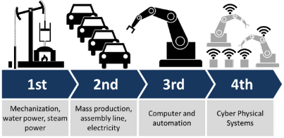
ITU-T Study Group 20: Internet of things (IoT) and smart cities and communities (SC&C)
Lead study group on
Internet of things (IoT) and its applications
Responsible for studies relating to IoT and its applications, and smart cities and communities (SC&C).
Smart Cities and Communities (SC&C), including its e-services
and smart services
The Fourth Industrial Revolution
It includes studies relating to Big data aspects of IoT and SC&C, e-services and smart services for SC&C
IoT identification
Next Meeting: 13-23 March 2017, Dubai, UAE
Notes:
The Fourth Industrial Revolution is fundamentally different from the previous three, which were characterized mainly by advances in technology.
In this fourth revolution, we are facing a range of new technologies that combine the physical, digital and biological worlds. These new technologies will impact all disciplines, economies and industries, and even challenge our ideas about what it means to be human.
These technologies have great potential to continue to connect billions more people to the web, drastically improve the efficiency of business and organizations and help regenerate the natural environment through better asset management, potentially even undoing all the damage previous industrial revolutions have caused.

Slide 27
New Resolution Enhancing the standardization of Internet of things and Smart Cities and Communities for global development
Highlights of this Resolution:
Considers the importance of IoT to contribute to achieving the 2030 Agenda for Sustainable Development.
Resolves to instruct ITU-T SG20 to develop ITU-T Recommendations aimed at implementing IoT and SC&C.
Instructs the Director of the Telecommunication Standardization Bureau
to carry out, in collaboration with Member States and cities, pilot projects in cities related to SC&C key performance indicator (KPI) assessment activities, aimed at facilitating the deployment and implementation of the IoT and SC&C standards worldwide;
to continue to support the United for Smart Sustainable Cities Initiative (U4SSC), launched by ITU together with the United Nations Economic Commission for Europe (UNECE) in May 2016, and share its deliverables with ITU-T Study Group 20 and other study groups concerned.
25 October – 3 November 2016

Slide 28
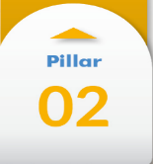
United for Smart Sustainable Cities (U4SSC) – new United Nations Initiative!
Setting the Framework
Connecting Cities and Communities
WG1
Urban planning
Policy, standards & regulation
Key performance indicators
WG2
Smart living
Smart mobility
Smart environment
Enhancing Innovation & Participation
WG3
Smart governance
Smart people
Smart economy
JOIN us now!
Notes:
U4SSC is a global platform for smart city stakeholders which advocates for public policy to encourage the use of ICTs to facilitate the transition to smart sustainable cities.
This initiative is supported by 15 other UN agencies and other International organizations and cities.

Slide 29
Publications on IoT and Smart Sustainable Cities
Flipbook on Shaping smarter and more sustainable cities: Striving for Sustainable Development Goals
Flipbook on Unleashing the potential of the Internet of Things
This compendium of Technical Reports and Specifications details policy and technical considerations relevant to the development of SSC, providing policymakers and engineers with valuable reference material to guide their pursuit of happier, safer life in our cities.
This flipbook presents a compendium of the first set of ITU international standards for IoT, providing a resource of great value to standards experts interested in contributing to the work of ITU-T Study Group 20.
Available on ITU website for free!

Slide 30
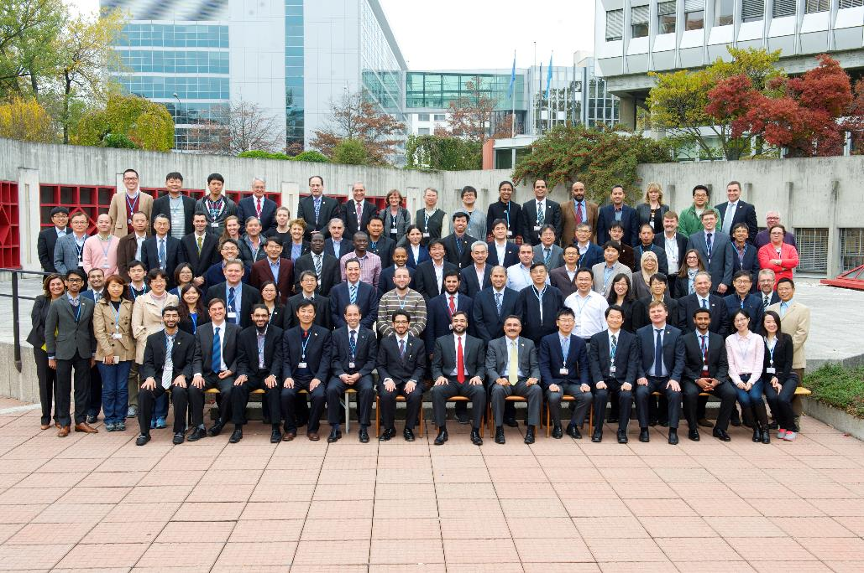
Next ITU-T SG20 meeting
ITU-T SG20 Meeting
13 - 23 March 2017, Dubai, UAE
Forum on “Accelerating IoT for Smart Cities”
12 March 2017, Dubai, UAE

Slide 31
Seventh edition of the Green Standards Week
3 – 5 April 2017
Save the date NOW!
Manizales, Colombia
Main topics
IoT and SC&C
Environment and Climate Change
Circular Economy
Hosted by the Municipality of Manizales

Slide 32
“Smart sustainable cities is a journey.
Not a final destination”.
Nasser Al Marzouqi,
Chairman, of the U4SSC
Notes:
Cities will have to make a CHOICE today

Slide 33
Thank you!
More information http://itu.int/go/tsg20
http://www.itu.int/en/ITU-T/ssc
tsbsg20@itu.int

